Slide 1

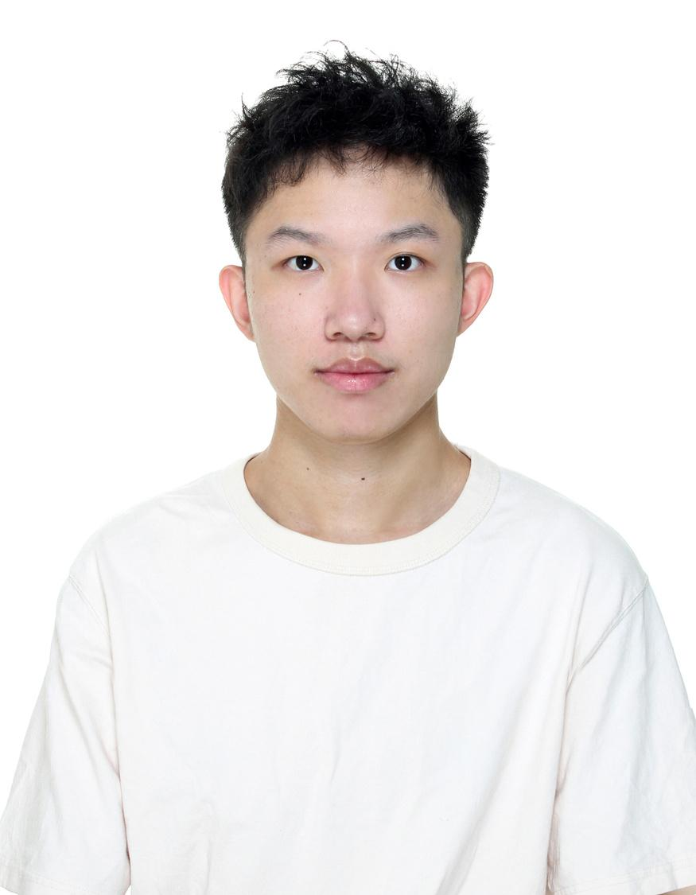

Mock Interview
Po-Chuan Chen

Slide 2





Outline
Mock Interview
More
Information
Experience
Project
Event

Slide 3










2022/09 - Present
M.S. Electronic Engineering
2023/09 - Present
Teaching Assistant
2020/07 - 2020/09
Summer Intern
2017/09 - 2021/06
B.S. Computer Science
2021/09 - 2023/07 (Quit)
M.S. Computer Science

Slide 4

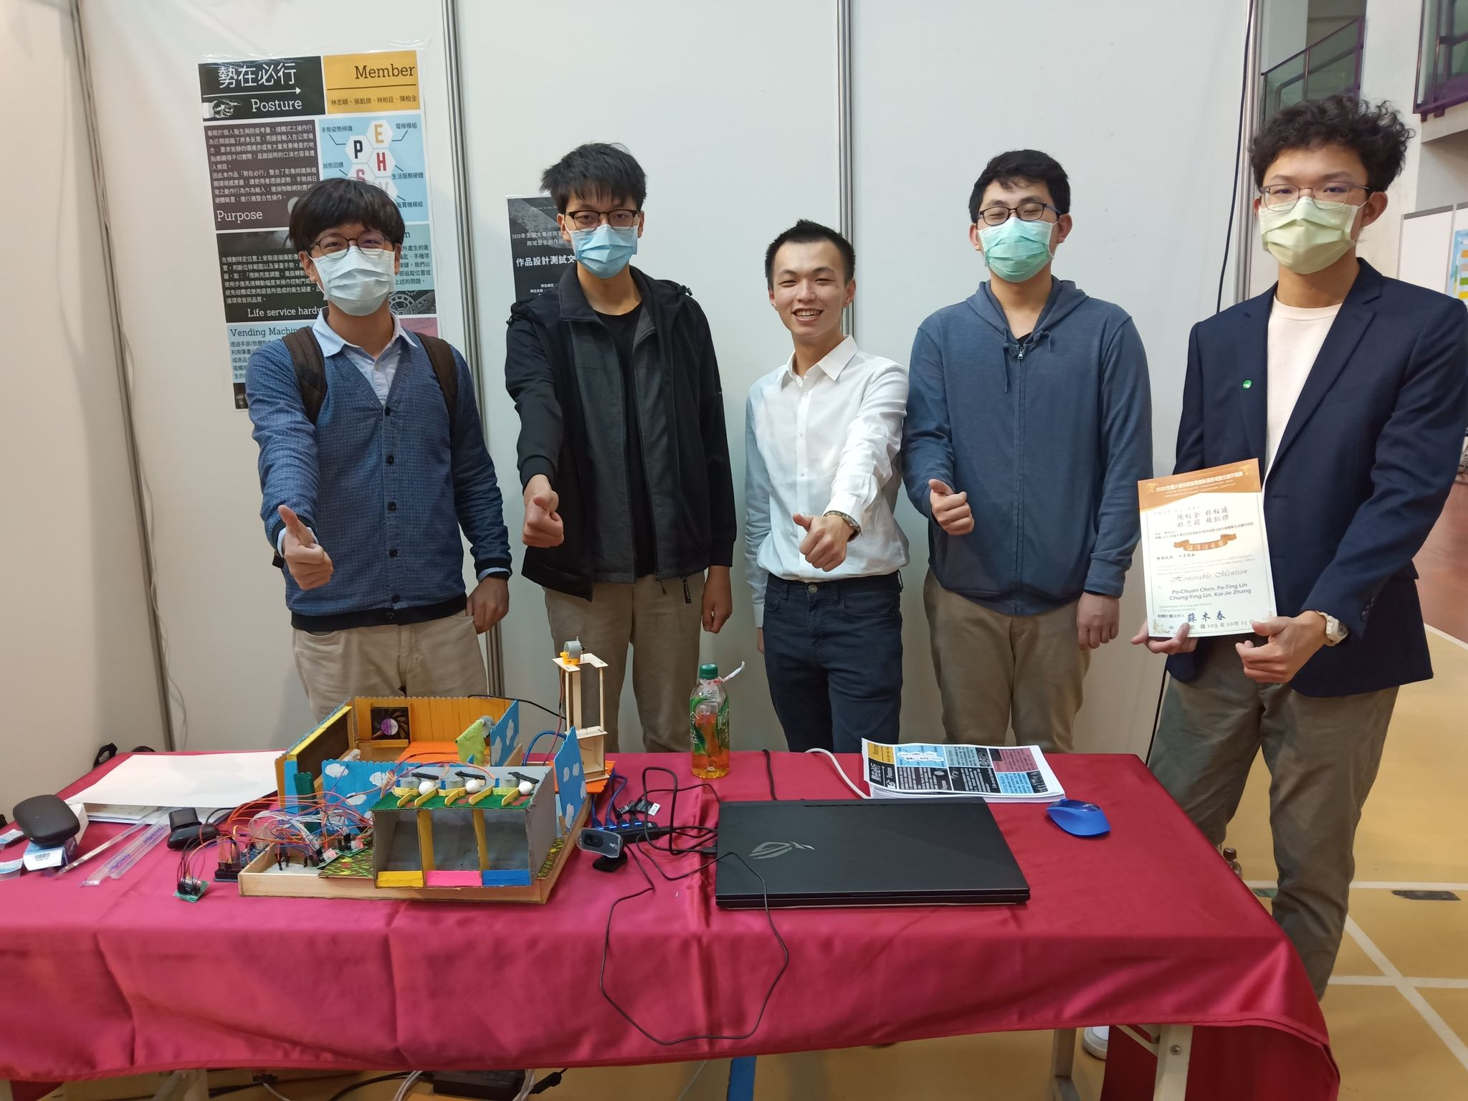

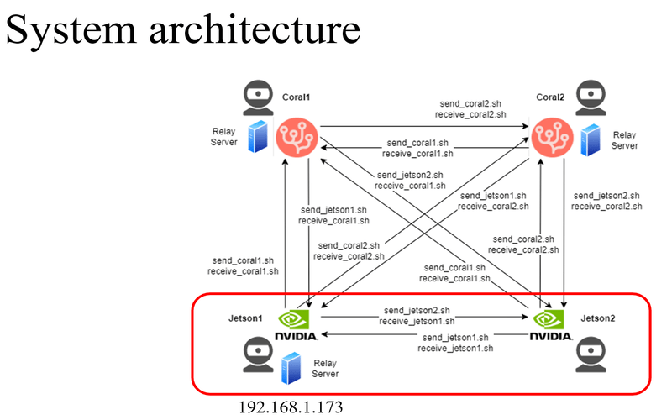
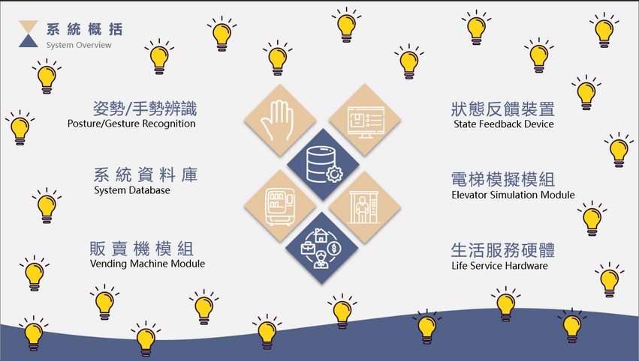
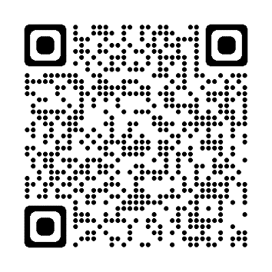

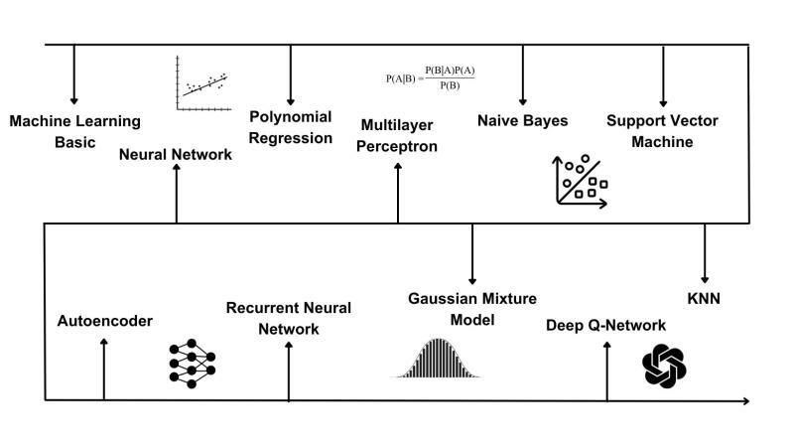
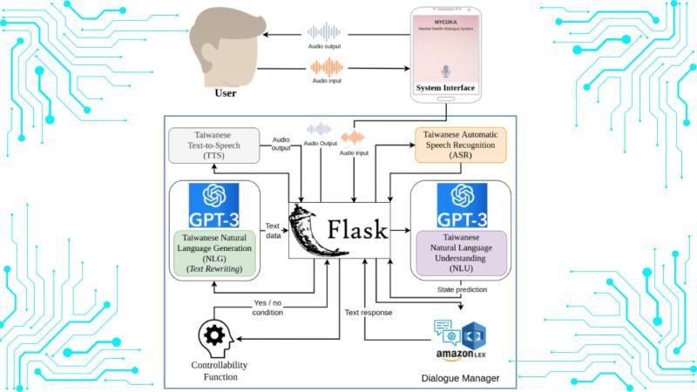
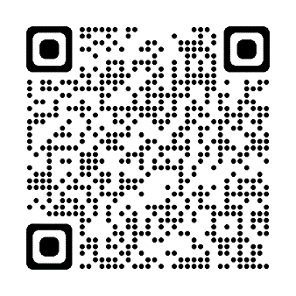
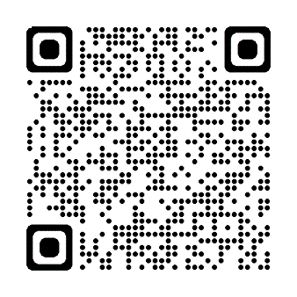
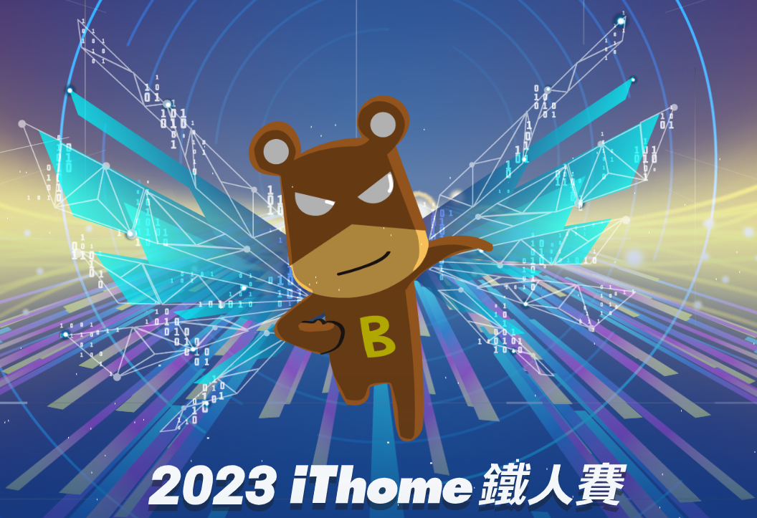
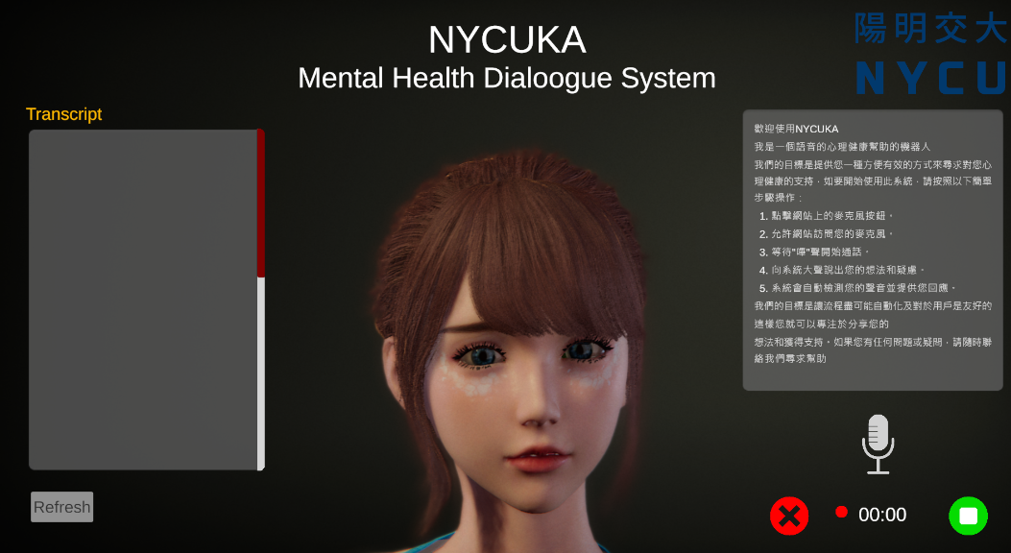
Posture
Independent Study @ CGU
P2P Objection Detection
Personal Research @ NTUT
ML from Scratch
Personal Side Project
Mental Health Chat-bot
Group Project @ NYCU

Slide 5
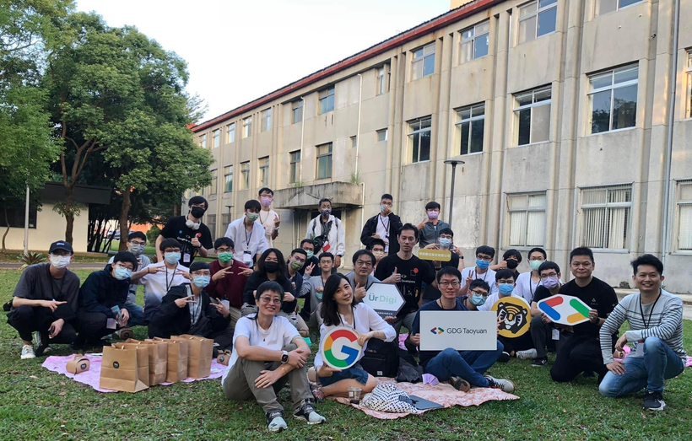
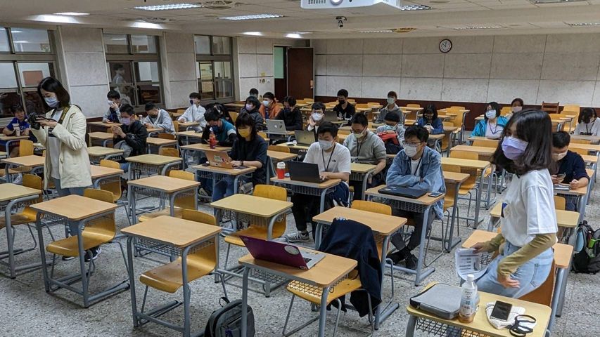



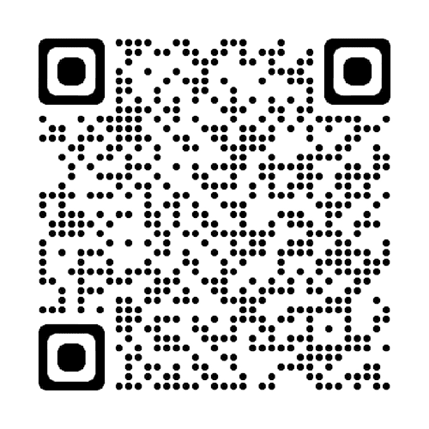

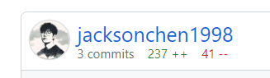
GDG Taoyuan
Devfest Taipei 2022
Python 官方說明文件
臺灣繁體中文翻譯計畫
Taoyaun 11/19
Taipei 12/16

Slide 6




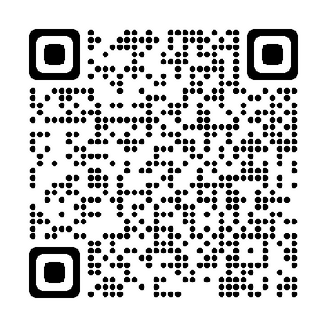
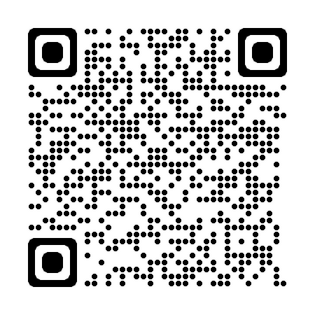


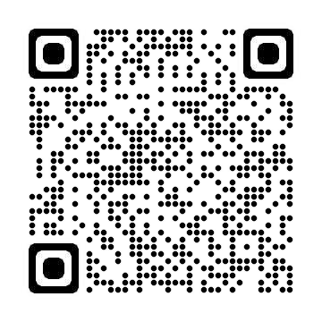
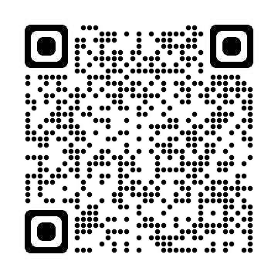

More ?
Connect ?
Article ?
Code ?

